Slide 1
Apache Sqoop
Hanoi – Autumn 2021

Slide 2
Apache Sqoop
Sqoop exchanges data between an RDBMS and Hadoop.
It can import all tables, a single table, or a portion of a table into HDFS.
Does this very efficiently via a Map-only MapReduce job
Result is a directory in HDFS containing comma-delimited text files (default)
Sqoop can export data from HDFS back to RDBMS

Slide 3
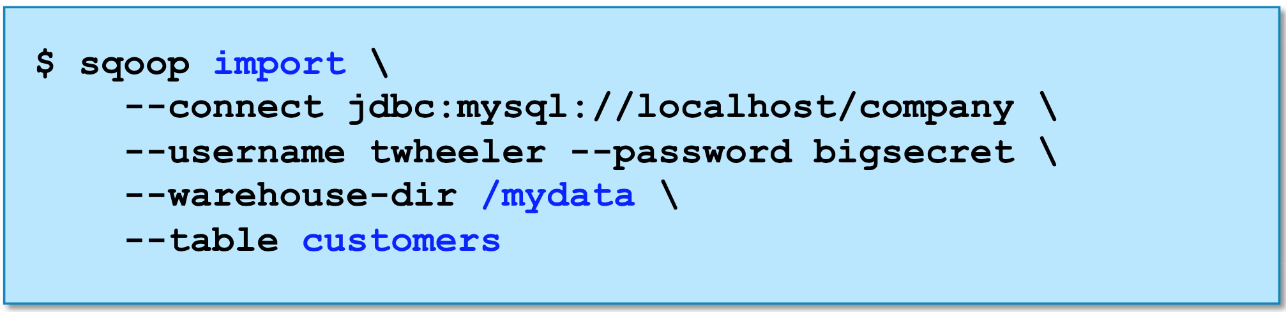
Importing Tables with Sqoop
This will imports the customers table from a MySQL database
Will create /mydata/customers directory in HDFS
Directory will contain comma-delimited text files.

Slide 4
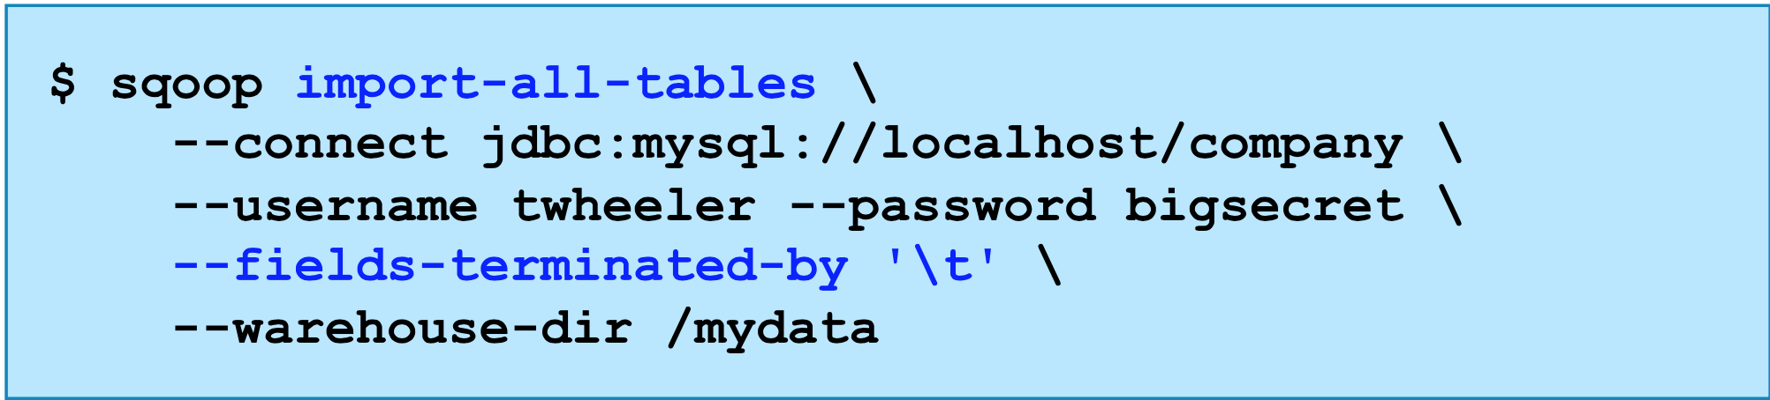
Importing An Entire Database with Sqoop
Import all tables from database (fields will be tab-delimited)

Slide 5
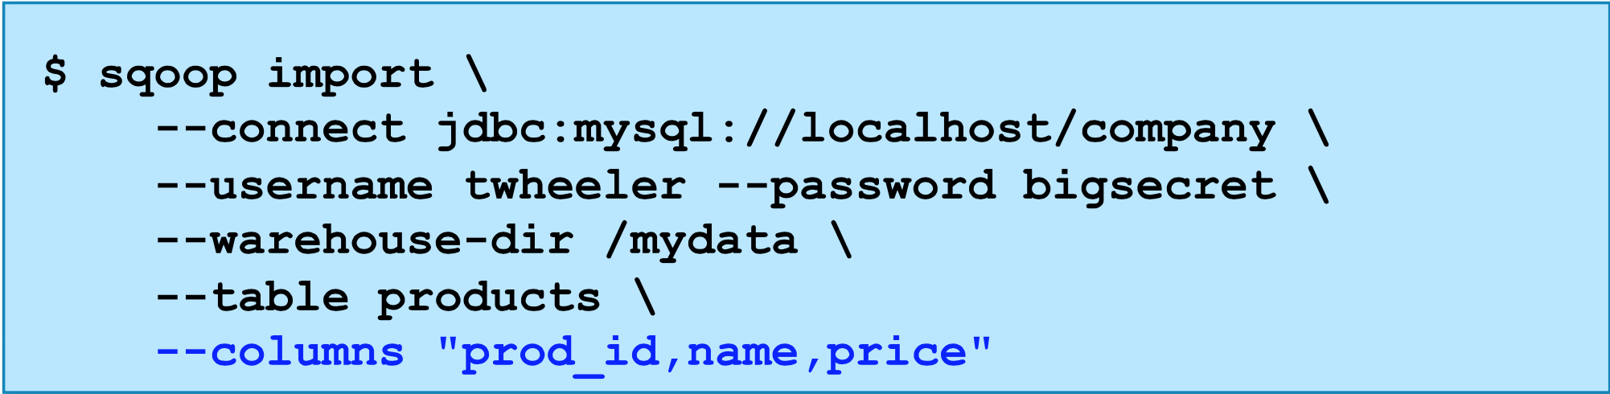
Importing Partial Tables with Sqoop
Import only specified columns from a table.

Slide 6
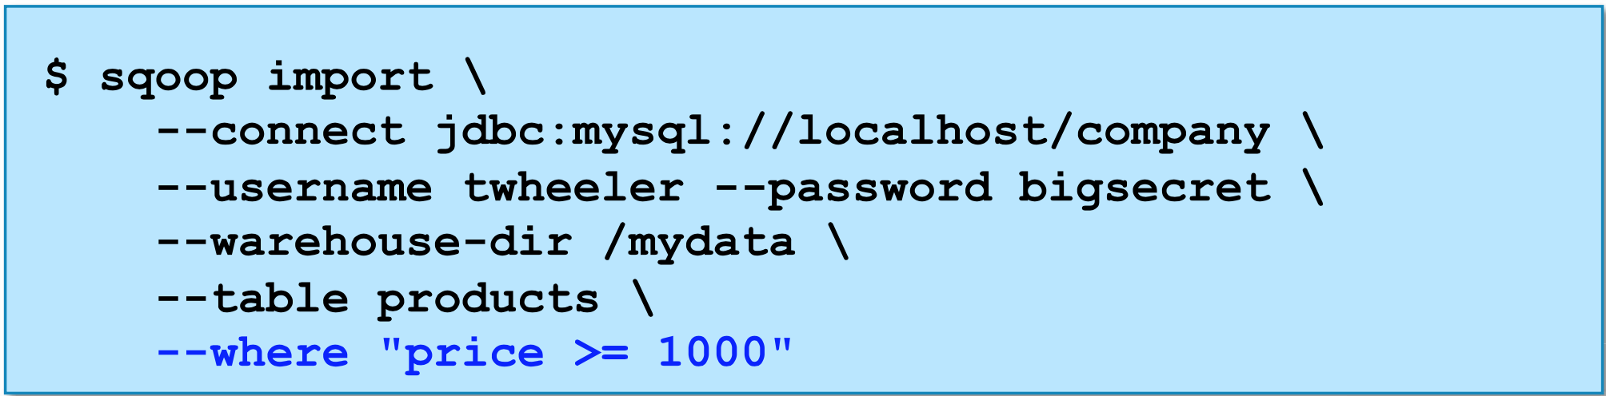
Importing Partial Tables with Sqoop
Import only matching rows

Slide 7
Importing With Free-Form Query
Must specify a destination directory with target-dir
The query must include the token $CONDITIONS
Must select a splitting column with split-by

Slide 8
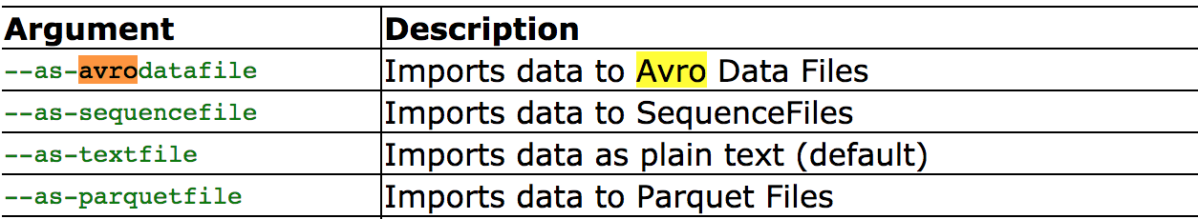
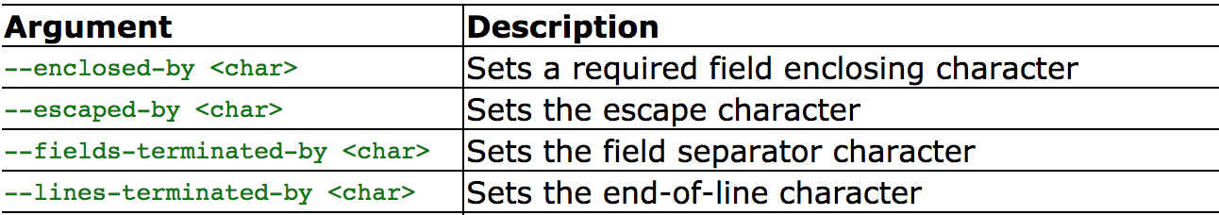
Arguments
Import control arguments
Output formatting arguments

Slide 9
Supported Database
Supports almost RDBMS
Support direct option for MySql and PostgreSQL to increase importing speed.

Slide 10
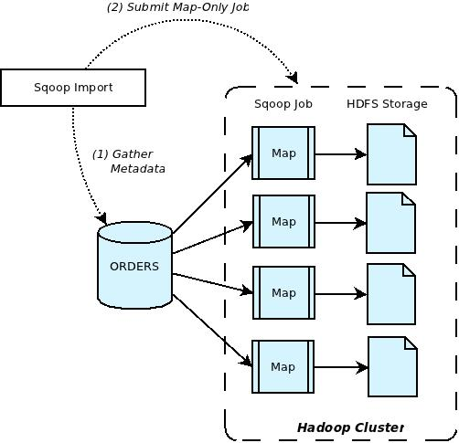
Apache Sqoop Architect
Notes:
Default 4 tasks are used.
Don’t use too much tasks.
Performing parallel, Sqoop needs a criterion to split the workload. Sqoop uses a splitting column to split the workload. By default, Sqoop will identify the primary key column (if present) in a table and use it as the splitting column. The low and high values for the splitting column are retrieved from the database, and the map tasks operate on evenly-sized components of the total range. For example, if you had a table with a primary key column of id whose minimum value was 0 and maximum value was 1000, and Sqoop was directed to use 4 tasks, Sqoop would run four processes which each execute SQL statements of the form SELECT * FROM sometable WHERE id >= lo AND id < hi, with (lo, hi) set to (0, 250), (250, 500), (500, 750), and (750, 1001) in the different tasks. If you don’t want default, use —split-by instead.
If a table does not have a primary key defined and the --split-by <col> is not provided, then import will fail unless the number of mappers is explicitly set to one with the --num-mappers 1

Slide 11
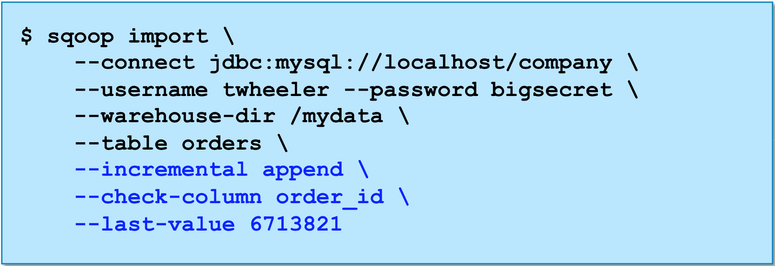
Incremental Imports with Sqoop
Sqoop’s incremental append mode imports only new records based on value of last record in specified column
Notes:
What if

Slide 12
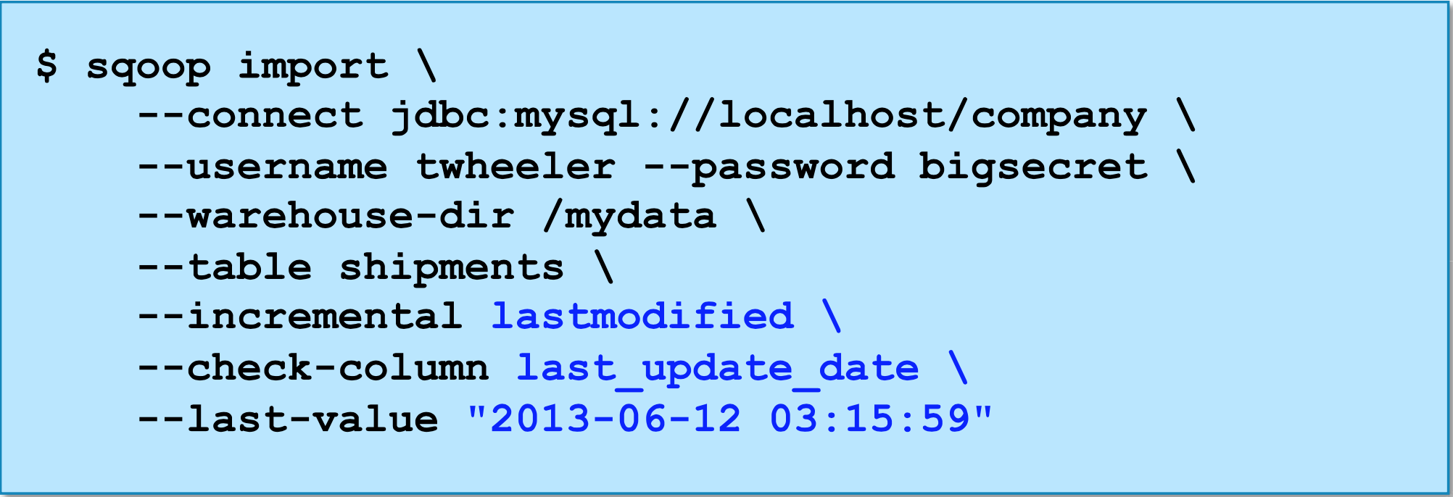
Handling Modifications with Incremental Imports
What if existing records are also modified in the databases?
Incremental append mode doesn’t handle this.
Sqoop’s lastmodified append mode adds and updates records

Slide 13
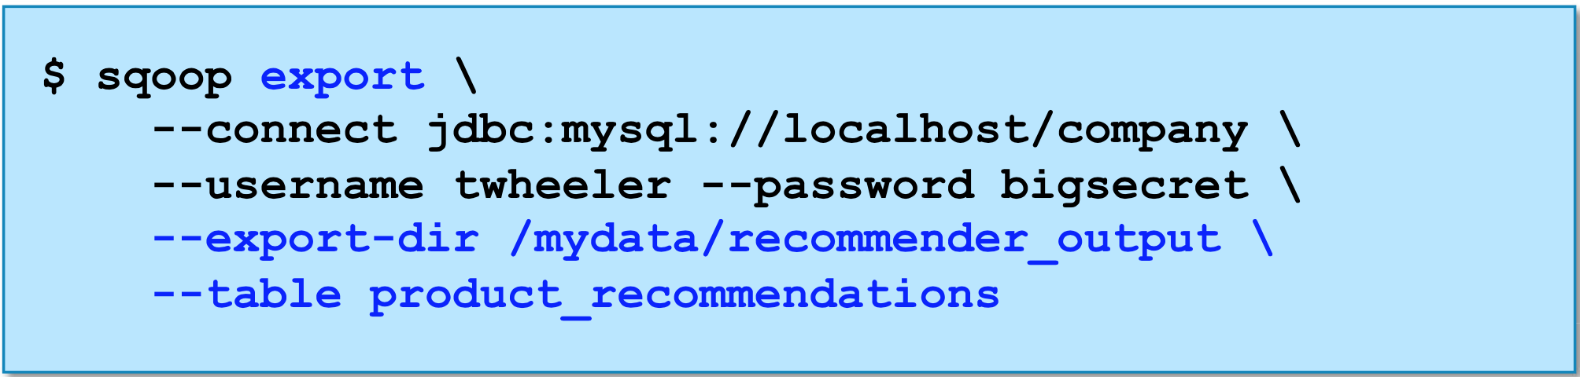
Exporting Data from Hadoop to RDBMS

